Slide 1
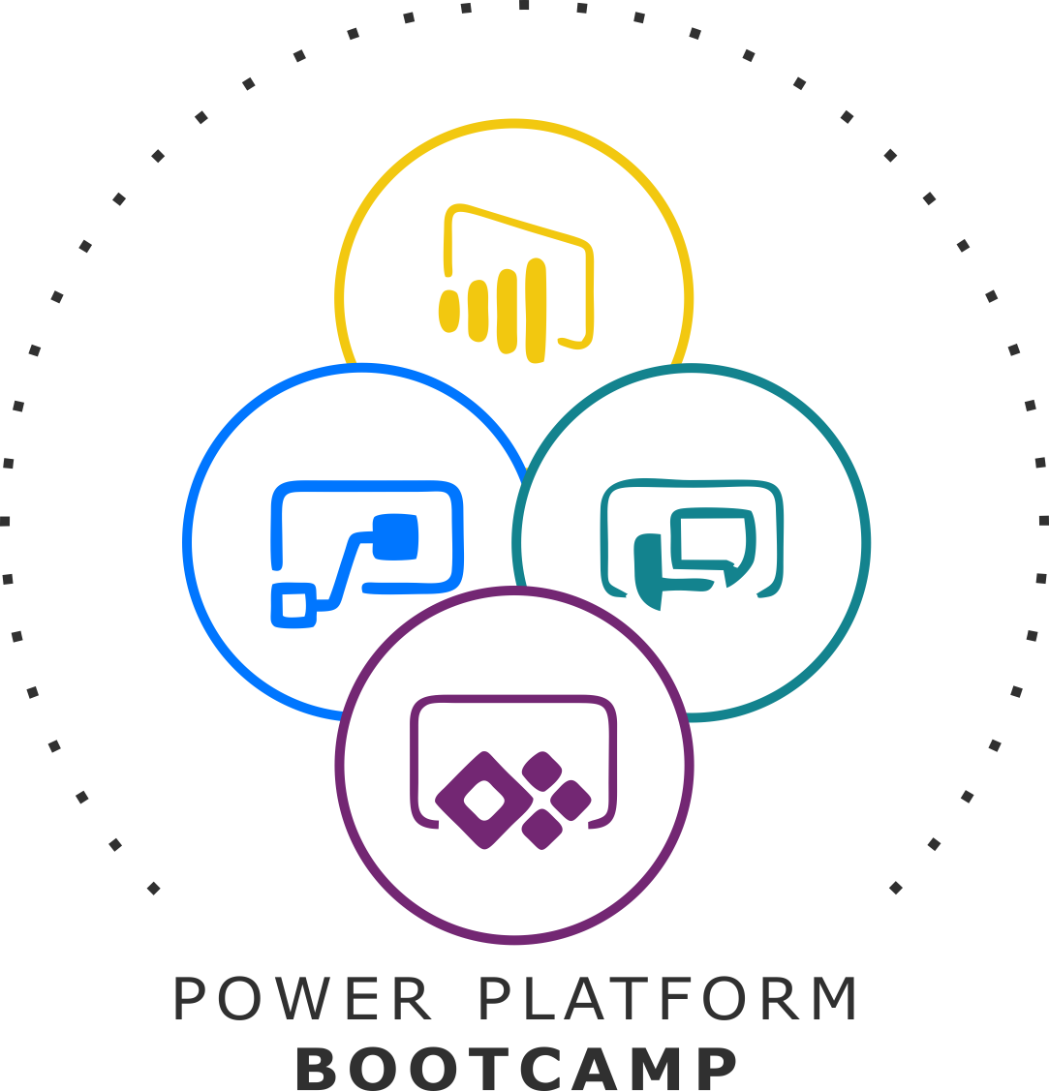
GLOBAL POWER PLATFORM BOOTCAMP
Organized Globally, Held Locally
@GPPBootcampBLR #GPPBootcampBLR #GlobalPowerPlatformBootcamp

Slide 2

Build enterprise ready solutions with Microsoft Power Platform
Skanda Ramana Suryanarayana
Senior technology Architect at Cognizant Technology Solutions
@SkandaRamana
@GPPBootcampBLR #GPPBootcampBLR
#GlobalPowerPlatformBootcamp

Slide 3



Sponsors

Slide 4
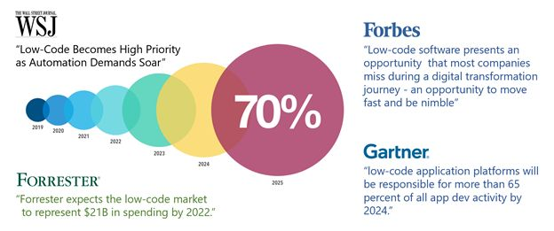
The Rise of Low Code platforms
Image courtesy – Graphite GTC
Notes:
Image courtesy Graphite GTC

Slide 5
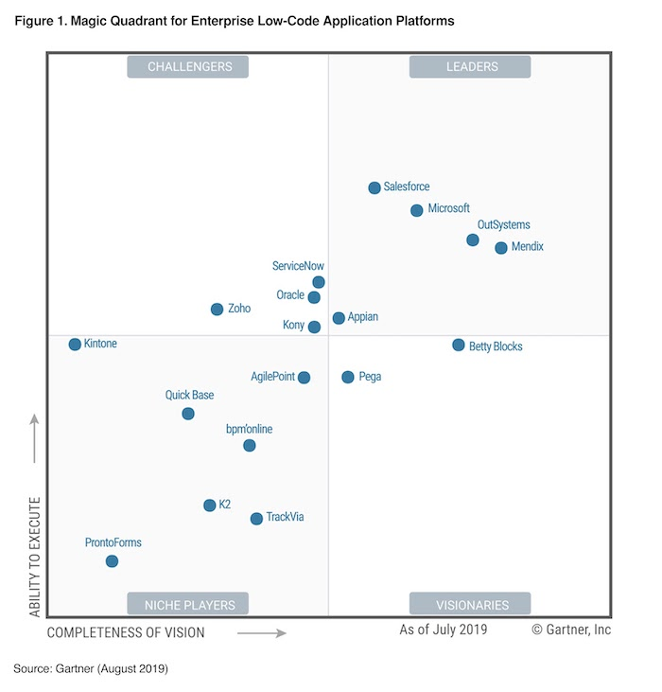
Magic Quadrant for Enterprise Low-Code application Platforms

Slide 6
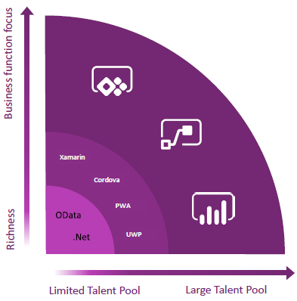
Take advantage of the opportunities together
The platform that enables everyone
Empower your business experts to create the apps they need to solve workflow and process challenges themselves. Enable IT to securely maintain/control data and govern business apps, while reducing application development backlog.

Slide 7
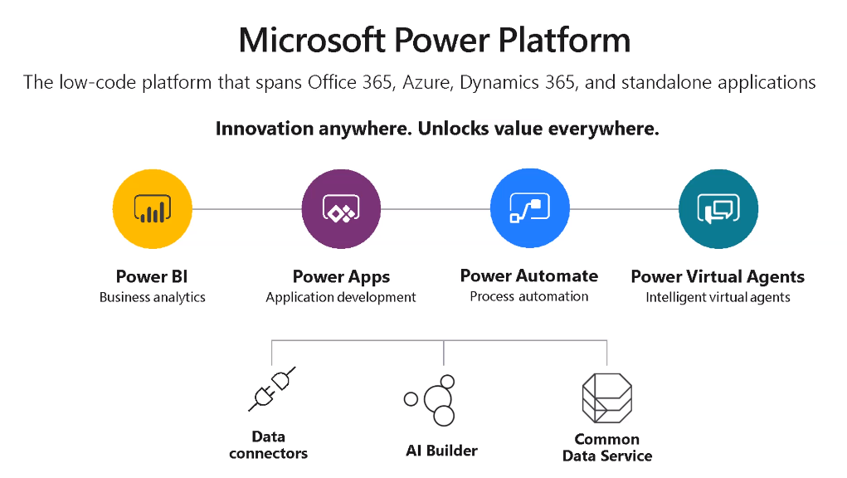

Slide 8
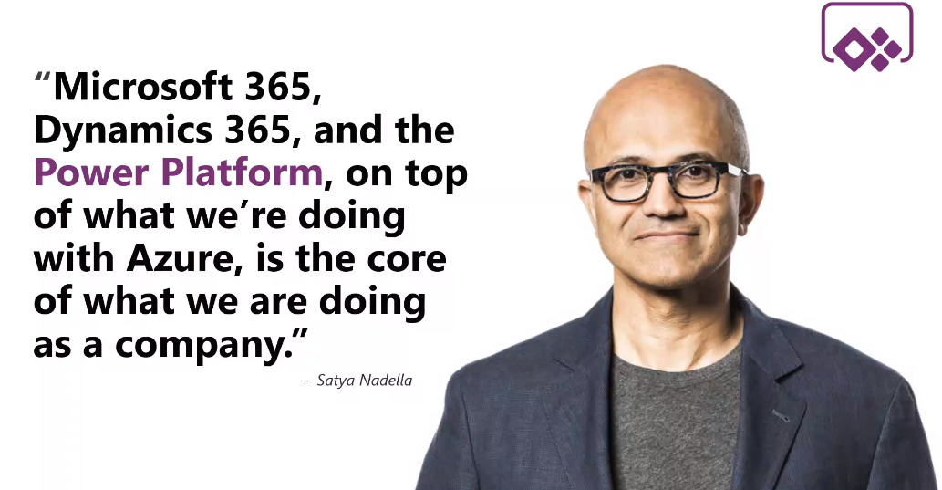

Slide 9
Advantages of Low Code platform
Rapid Development
Industry Best Practices
Code Quality
Integration
Security
Deployment & Testing

Slide 10
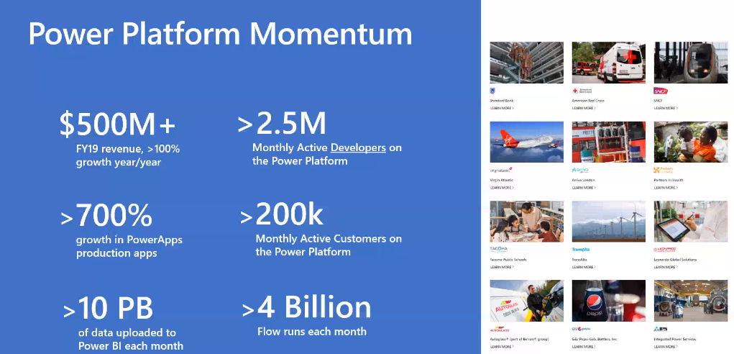

Slide 11
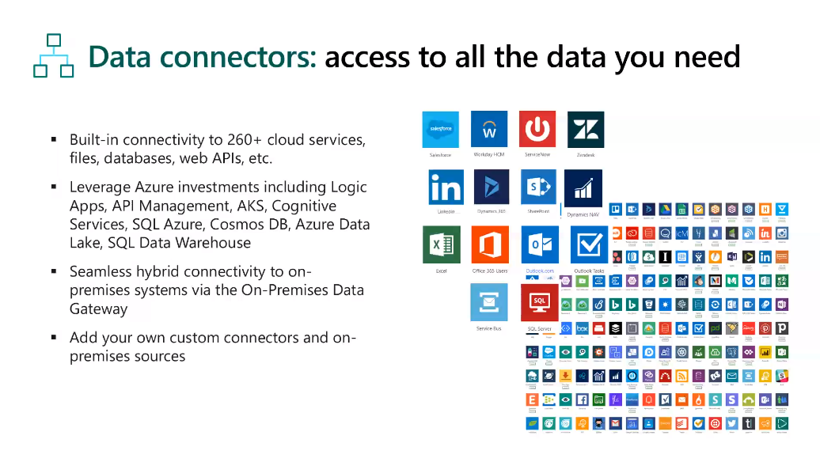

Slide 12
DEMO

Slide 13
Any Questions?

Slide 14
Leverage Power Platform with CDM & CDS
Next Session:
Manoj Mittal
Senior Solutions Architect, SharePoint & O365
Vipin Tyagi
Senior Analyst, SharePoint

